Slide 1
Small Business - Team 3
Councillor Worrell
By Galo Guerra, Jiahua Zhang, Xingru Chen, and Andrew Wang

Slide 2
What is the Goal of our project?
Our project was specifically focused in on two key questions from the original draft we were given:
What businesses exist?
What businesses are overrepresented?

Slide 3
Progress So Far:
Our team analyzed the provide Boston Planning and Development Agency’s data in order to research this topic. We restricted the full listing of businesses to those located in District 4 using the provided shape file as well.
Most of defining business types was done through the NAICS descriptive codes, which were provided in the BPDA dataset.

Slide 4
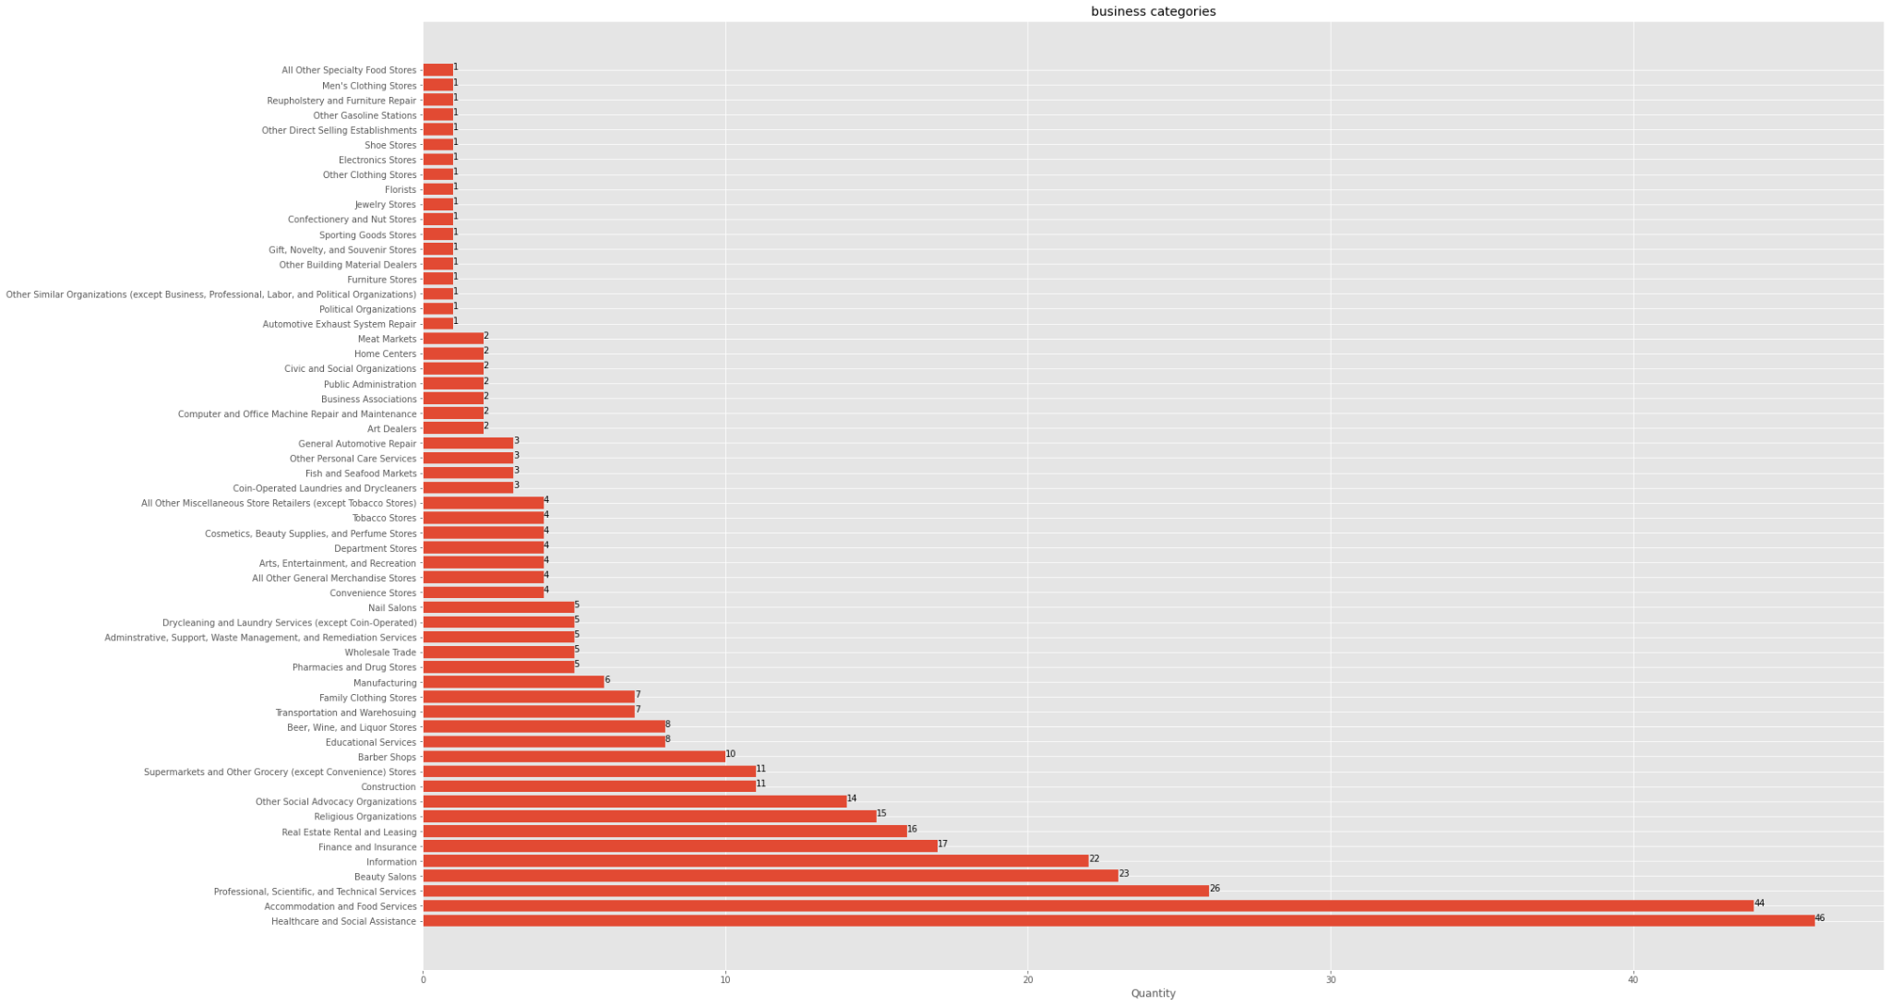
Answering Our Key Questions

Slide 5
NAICS-2017-2digit Identifiers
Real Estate Rental and Leasing
Professional, Scientific, and Technical Services
Management of Companies and Enterprises
Administrative and Support and Waste Management and Remediation Services
Educational Services
Health Care and Social Assistance
Arts, Entertainment, and Recreation
Accommodation and Food Services
Other Services
Public Administration
Agriculture, Forestry, Fishing and Hunting
Mining
Utilities
Construction
Manufacturing
Wholesale Trade
Retail Trade
Transportation and Warehousing
Information
Finance and Insurance
Undefined

Slide 6
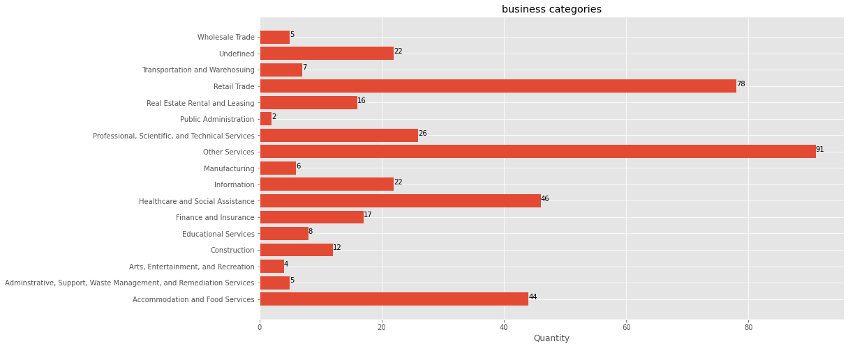
Adjustments
It is clear from the graph that “Other Services” and “Retail Trade” are far overrepresented compared to the other descriptors, however neither are actually very descriptive.

Slide 7
Adjustments
Now using the NAICS-6digit descriptions in place of “Retail Trade” and “Other Services”, here are a few examples of how the categories were broken down:
Tobacco Stores
Supermarkets and Grocery Stores
Sporting Goods Stores
Shoe Stores
Pharmacies and Drug Stores
Gasoline Stations
Other Direct Selling Establishments
Other Building Material Dealers
Clothing Stores
Meat Markets
Jewelry Stores
(etc.)
Reupholstery and Furniture Repair
Religious Organizations
Political Organizations
Other Social Advocacy Organizations
Personal Care Services
Nail Salons
General Automotive Repair
Beauty Salons
Barber Shops
Civic and Social Organizations
Computer and Office Machine Repair and Maintenance
(etc.)
Retail Trade:
Other Services:

Slide 8
What does the graphic indicate?
The top graph is our original graph that only used NAICS-2digit descriptions for the various businesses around District 4
This graph contains 17 different business types
The bottom graph now contains NAICS-6digit descriptions in place of “Retail Trade” and “Other Services”
This graph contains 58 different business types

Slide 9
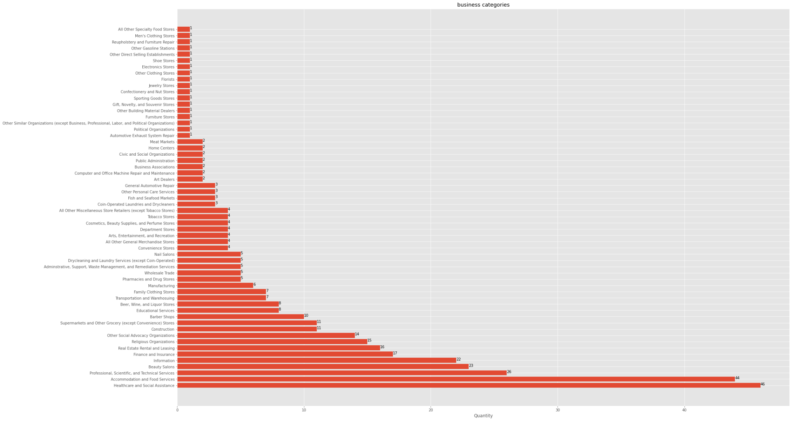

Slide 10
Results from Graph
It is clear to us that to get the most out of the graph, some trade off is to be made between more descriptive 6digit and less descriptive 2digit.
6digit categories still can make up large portions of the businesses, though 2digit dominates.
Largest Categories in District 4:
Healthcare and Social Assistance (2digit) - 46
Accommodation and Food Services (2digit) - 44
Professional, Scientific, and Technical Services (2digit) -26
Beauty Salons (6digit) - 23
Information (2digit) - 22

Slide 11
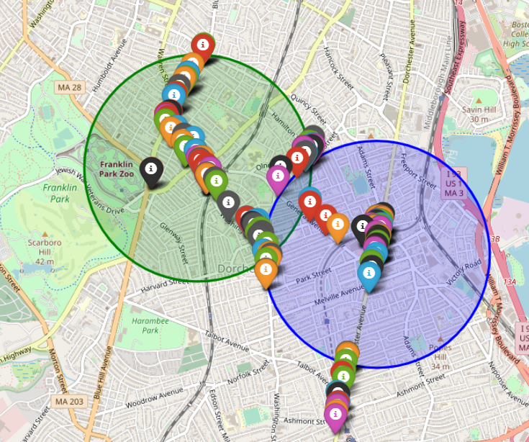
https://colab.research.google.com/drive/1_7zUFTw2x3bLghx1Noqr9SaZluoqtAaf?authuser=1#scrollTo=SDZGbnoKbOFM

Slide 12
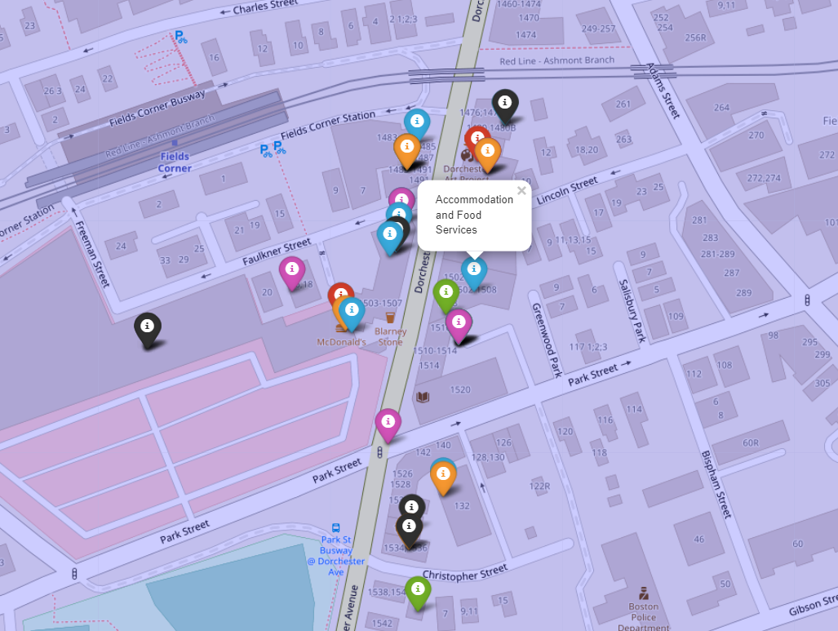
Explanation of Map.html
Each label represents a business within district 4
Each color represents a descriptor for a business (next slide)
The two large circles are clusters we used to determine proximity between businesses
Businesses within clusters are tested only against each other for overrepresentation

Slide 13
Color Breakdown of map.html
Map.html graphs the 7 most prevalent business types:
Blue = Accommodation and Food Services
Purple = Information
Green = Healthcare and Social Assistance
Red = Beauty Salons
Orange = Professional, Scientific, and Technical Services
Black = Finance and Insurance
Grey = Religious Organizations

Slide 14
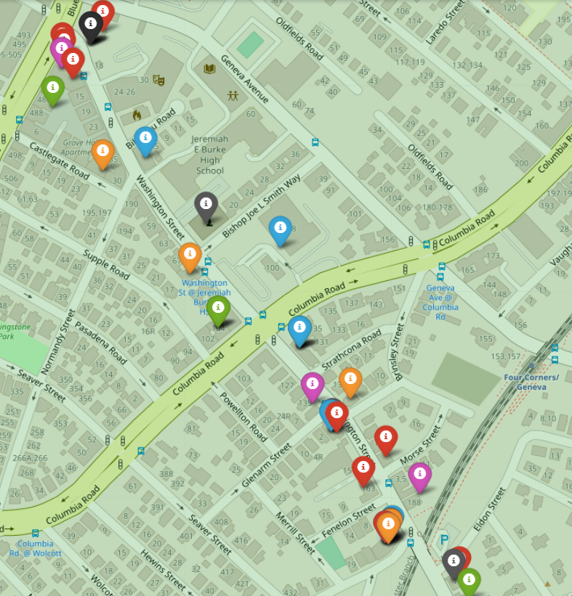
What we learned from our map
Thankfully, no business is restricted to one part of district 4, as all our largest types seem to be spread across the district.
However, where there's’ one, there’s usually many more, like for example the heavy number of beauty salons on Washington Street.
There is refinement to be made in judging appropriate distance between similar businesses, as our clusters were imprecise.

Slide 15
Challenges and Limitations
As a team there were 2 main issues we attempted to resolve:
Some businesses in the dataset could not be considered small businesses. One example being Xfinity. However, we decided to keep these in the data as these large companies still take away business from small businesses as well as compete for storefronts with them. We are open to changing this however.
Some categories were too non-specific or unhelpful. While we could fix this issue with “Other Services” by using the 6digit representative,, others we did not. The 2digit category “Undefined” was entirely removed, as it had no 6digit descriptors and appeared to be mostly housing units.

Slide 16
Our Next Steps
Some points we were considering to refine our key questions going forward:
Looking at business data from other districts, so far we’ve only tried to find overrepresentation within the district itself
How to refine the map for readability / provide more data to the viewer without background knowledge
Review our graphs and see if there are any improvements to be made with visualization or list of businesses

Slide 17
Explanation of Extension Project
Comparison of District 4 to other districts, as well as introducing two new datasets:
Food establishments
Look at alcohol licenses
Too many? Too little?
Is there enough distinguishment between full-service / no-service restaurants?
Cannabis License datasets
How has the industry grown in District 4 / Boston since 2016?
Is it even present in/near district 4?

